Slide 1
Machine Learning for Predictive Maintenance: A Multiple Classifier Approach
Ambuj Kumar Mondal
30-March-2022
Supervisor: Prof. Dr. Theodor Lettmann

Slide 2

Agenda
PdM
Intelligence of Prediction
Maintenance types
Importance of PdM
Machine Learning in PdM
Supervised Learning
Unsupervised Learning
Semi-supervised Learning
Multiple Classifier Approach
Tradeoff Optimization
MC PdM algorithm
Classification algorithms
Use case and Experiment
Semiconductor manufacturing
Challanges & future tasks
Conclusion
[pic0]
ML for PdM: MC approach By: Ambuj Kumar Mondal

Slide 3
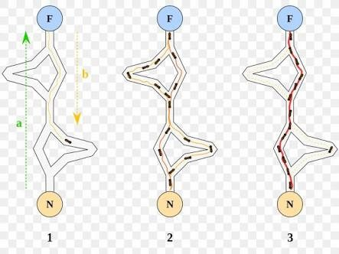
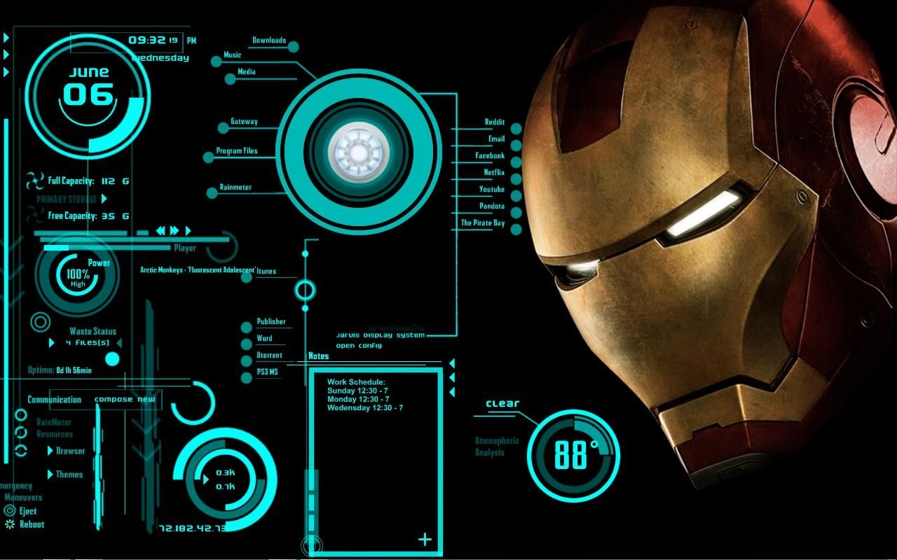
Intelligence of Prediction
“The ability to perceive or infer information, and to retain it as knowledge to be applied towards adaptive behaviours within an environment or context” [wikipedia]
Artificial Intelligence : is the design of artificial agents that perceive their environment and make decisions to maximise the chances of achieving a goal.[2]
[pic1]
[pic2]
ML for PdM: MC approach By: Ambuj Kumar Mondal

Slide 4
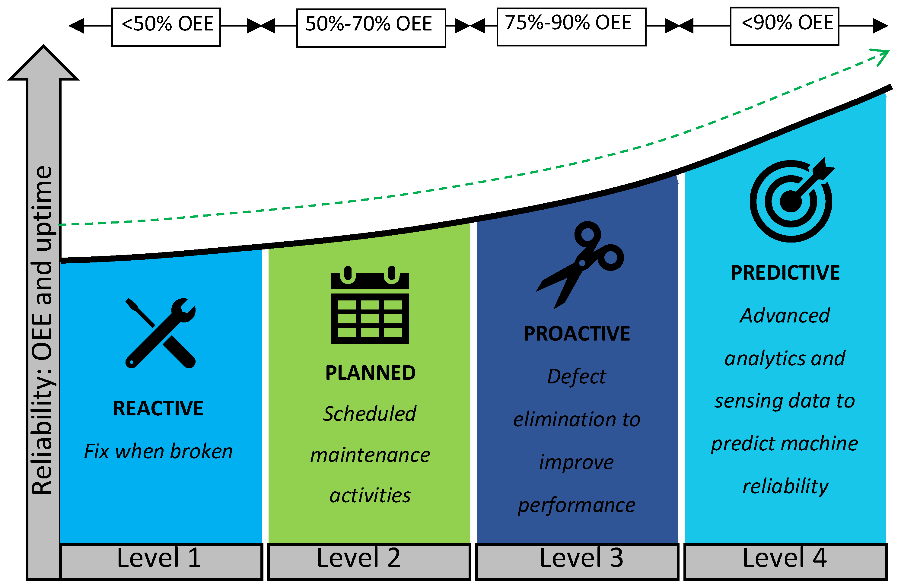
Maintenance Activities
R2F- Run to Failure Descriptive Diagnostic
PvM- Preventive Maintenance Scheduled maintenance Planned Activities Avoid breakdowns
PdM- Predictive Maintenance Failure Prevention Efficient Operations Reduced maintenances frequency
[pic3] : Different ways of Maintenance
ML for PdM: MC approach By: Ambuj Kumar Mondal

Slide 5
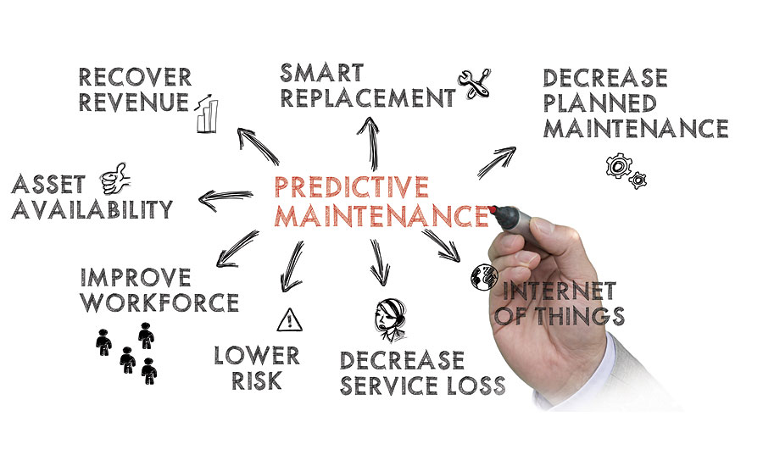
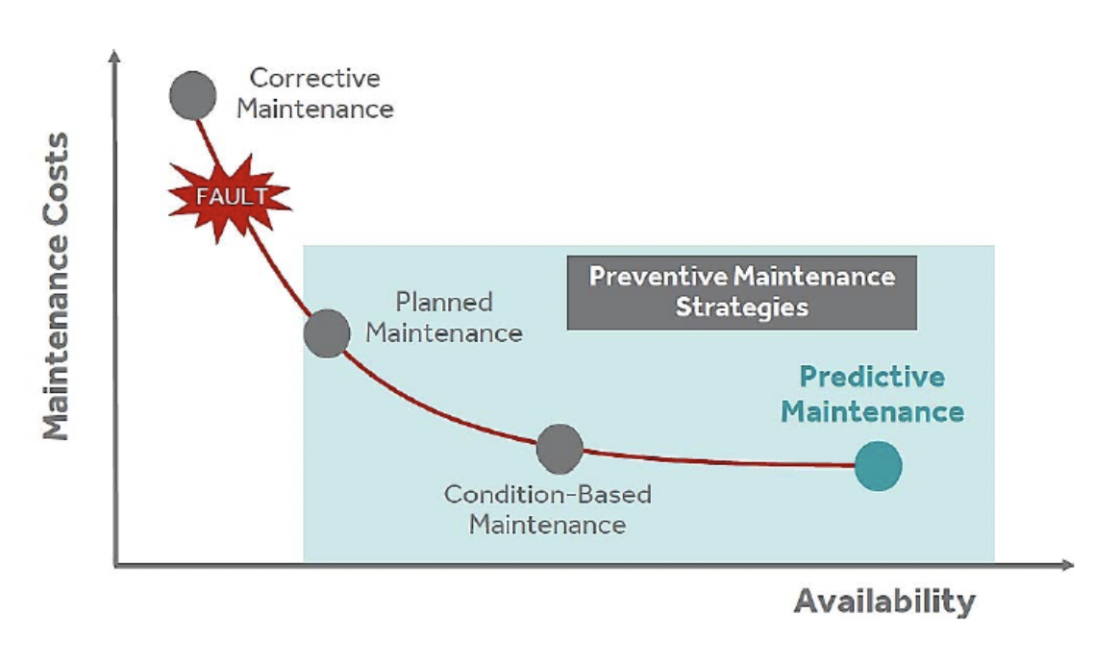
Why Predictive Maintenance (PdM)
[pic4] : Benefits of Predictive Maintenance
[pic5] : Cost vs availability, different maintenance approaches [MPR18]
ML for PdM: MC approach By: Ambuj Kumar Mondal

Slide 6
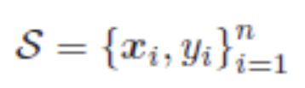
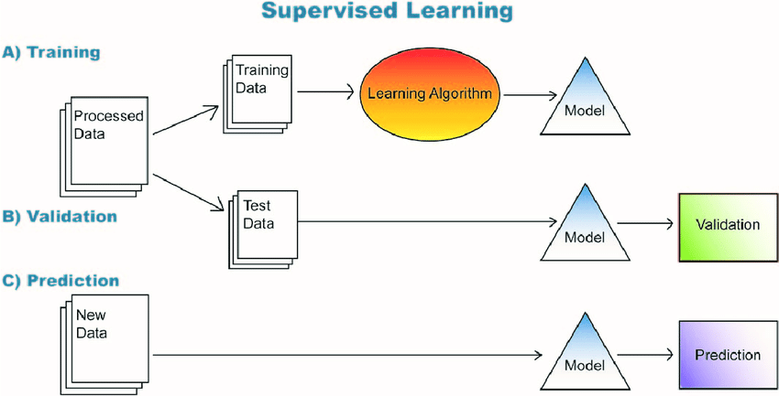
Machine Learning in PdM
Supervised Learning
Needs the availability of labelled dataset S
Classification and Regression
[pic6] Supervised Learning steps
ML for PdM: MC approach By: Ambuj Kumar Mondal

Slide 7
Supervised Machine Learning in PdM
Classification:
Algorithm for accurately assigning input data into a specific class.
SVMs – Support Vector Machines, K-NN – K Nearest neighbours
Regression:
Algorithm for understanding the relationship between different dependent and independent entities
Linear Regression, Logistic Regression, Polynomial regression
Remaining Useful Lifetime (RuL): duration that a machine can run further before it faces a breakdown, provided no maintenance activity was performed. [BR10]
ML for PdM: MC approach By: Ambuj Kumar Mondal

Slide 8
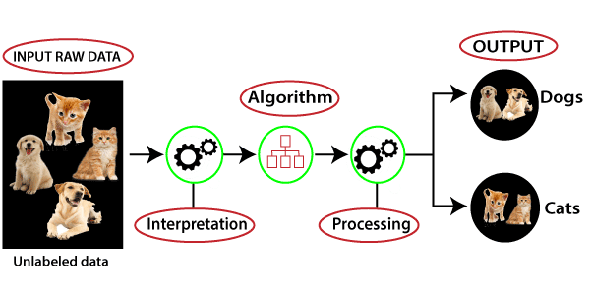
UnSupervised Learning in PdM
UnSupervised Learning:
Data is given as input and the algorithm finds hidden structures in the data
useful in clustering problems and probability density estimation
complex compared to supervised models.
Need more CPU cores and processing powers.
[pic7] Unsupervised Learning steps
ML for PdM: MC approach By: Ambuj Kumar Mondal

Slide 9
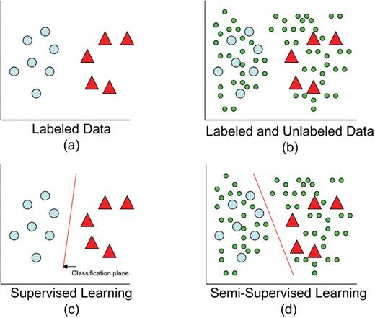
Semi Supervised Learning
Practical Scenario
Data for a particular state is known and most data for the complete system is not known or labelled
predict a target value for a specific input data set and can detect outliers.
needs proper knowledge about normal production behaviour.
useful in Anomaly Detection and One-Class classification problems.
[pic8] Difference between supervised and semi supervised learning methods
ML for PdM: MC approach By: Ambuj Kumar Mondal

Slide 10
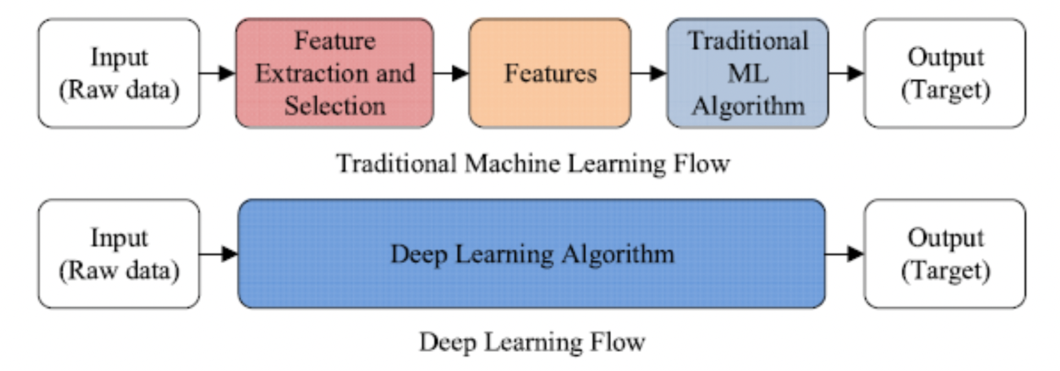
Machine Learning Flow
Data Exploration:
Sensor data, Logs, Monitoring data
Feature Extraction:
Data Interpolation
mathematical value that can be used to train the machine learning algorithm
Manufacturing industry – thousands of possible features.
Feature Selection is important – Average, standard deviation, skewness, Kurtosis etc.
[pic9] Flow of Ml and DL [ZYW19]
ML for PdM: MC approach By: Ambuj Kumar Mondal

Slide 11
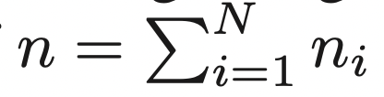
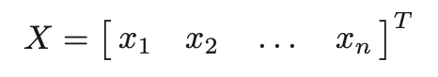
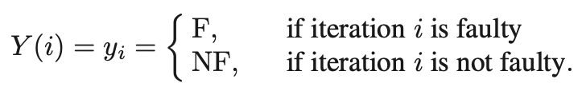
PdM approach
Classification of PdM: [ZYW19]
Assume data of N maintenance cycles available
Define matrix X containing all the collectible information
Information on maintenance events is contained in the variable Y
Weak Form: [ZYW19]
In the case of R2F, each cycle results in F - Dataset is unbalanced and skewed.
Only current process iteration is classified. No fault prevention
No operating cost optimization policy
Key Metrics – Frequency of unexpected breaks (FuB) - percentage of failures not prevented Amount of unexploited lifetime (FuL) – number of iteration that could have run before breakdown
ML for PdM: MC approach By: Ambuj Kumar Mondal

Slide 12
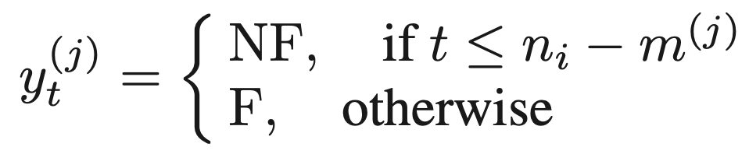
MC PdM Concept
Costs, CuB and CuL associated with for FuB anf FuL; CuB relates to unplanned interruptions in Production. CuB >> CuL
an optimal tradeoff solution is sought through minimization of the total operating costs J = FuB.CuB +FuL.CuL
Possible approach to prevent unexpected failures- optimize J
Label last m iterations as F instead of considering just last failed cycle and reduce skewness of Dataset.
The j^{th} classifier is associated with the labels Y^{j}, where considering the t^{th} process iteration of the i^{th} maintenance cycle (of length n_{i})
ML for PdM: MC approach By: Ambuj Kumar Mondal

Slide 13
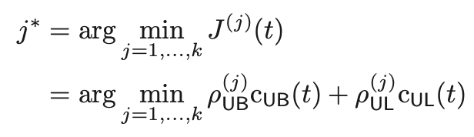
Tradeoff Optimization
N_{m} samples for F and n-N_{m} samples for the class NF. This can be repeated with k different values of horizon m.
given the current costs CuB(t) and CuL(t) at time t, the MC PdM suggests a corrective action when the j^{th} classifier
Algorithm 1: [ZYW19]
In the performance of each classifier is evaluated using repeated random subsampling validation, also known as Monte Carlo cross validation (MCCV)
MCR[%] = Percentage of misclassified samples
Tuning by cross validation with MCR
ML for PdM: MC approach By: Ambuj Kumar Mondal

Slide 14
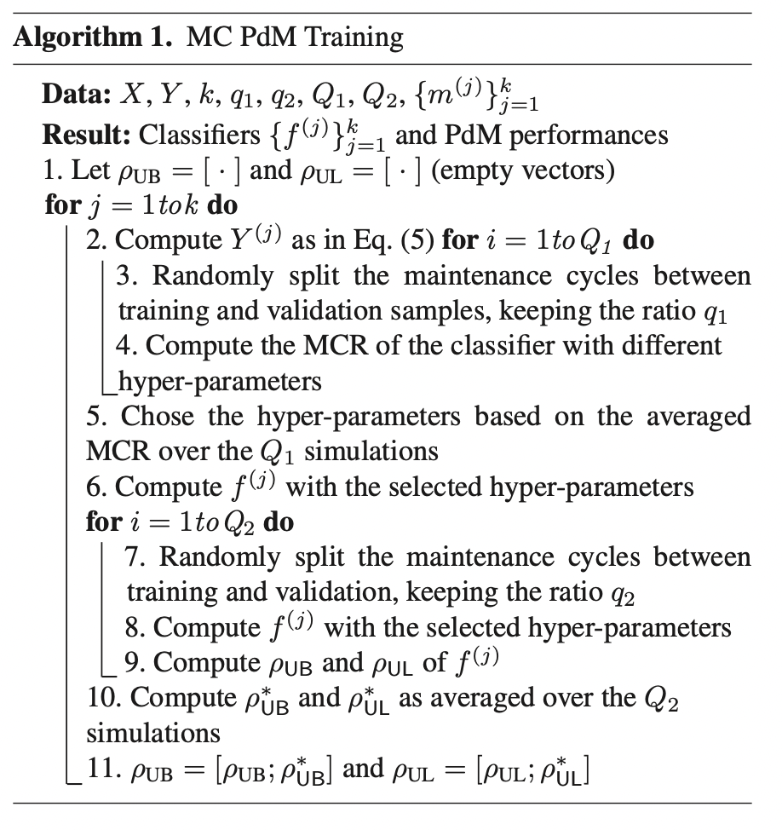
Mc PdM Algorithm
CuB and CuL are provided by the user, and may be changed at each evaluation of the PdM module
Unexpected breakdown brings a full maintenance cycle
Valuable new data are available to update the MC PdM module and related performance metrics
It is important to retain the facility to update the MC PdM module following deployment.
[Dignum, 2017]
Algortihm : MC PdM [SSP+14]
ML for PdM: MC approach By: Ambuj Kumar Mondal

Slide 15
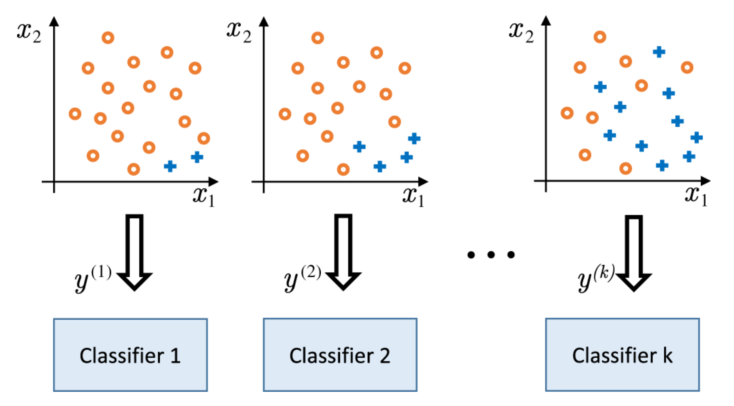
K Classifiers
For integral type faults – normal wear and tear effects
Effectively deal with unbalanced datasets
Performance of the MC PdM methodology increases with the number of classifiers k
[pic10] Two-dimensional example of k classifiers. [SSP+14]
ML for PdM: MC approach By: Ambuj Kumar Mondal

Slide 16
Classification Algorithms
Support Vector Machines (SVMs)
A hyperplane is defined such that it separates the two classes F and NF with the highest margin.
In real classification problems, classes are often non separable, i.e., the two categories overlap
The computational cost for training a nonlinear SVM is generally between O(n2) and O(n3)
employed radial basis function (RBF) kernels to implement the nonlinear classification boundaries in the linear framework. RBF is always an absolute value
ML for PdM: MC approach By: Ambuj Kumar Mondal

Slide 17
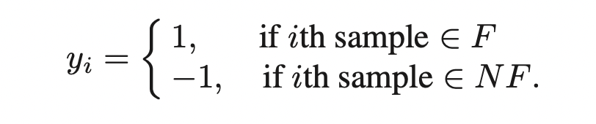
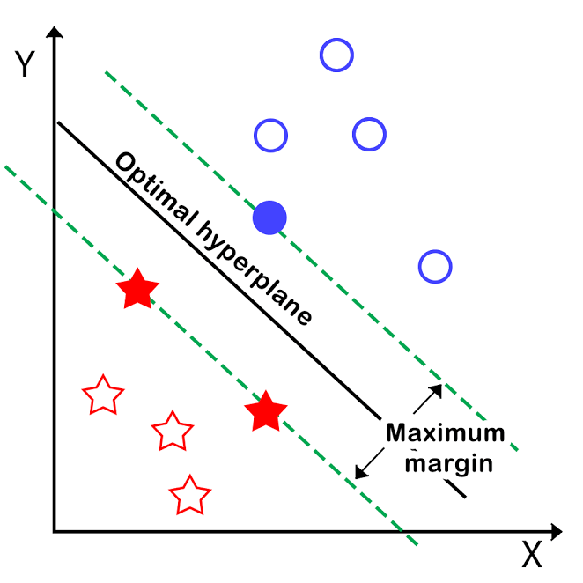
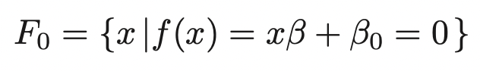
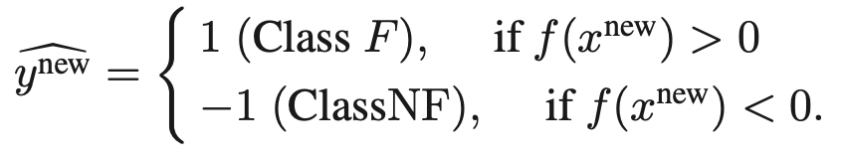
MC PdM- svm
training dataset S is available and the values {−1, 1} are assigned to the two classes
define the hyperplane F₀ in the space
classification is then based on the choice of f(x)
for a new sample x^{new} not belonging S
[pic11] SVM classifier
ML for PdM: MC approach By: Ambuj Kumar Mondal

Slide 18
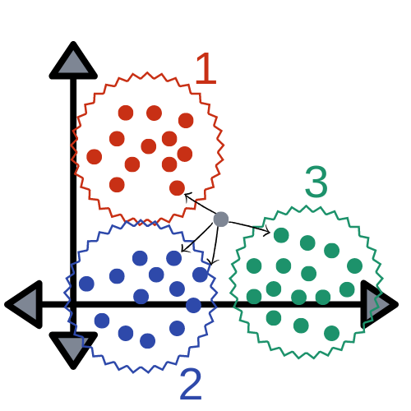
Classification Algorithms
K Nearest Neighbours (k-NN)
requires just computation of Euclidian distances between samples.
each point of the input space is labelled according to the labels of its k closest neighbouring samples
choice of k is usually data-driven (often decided though cross-validation
larger values of k reduce the effect of noise on the classification
optimized algorithms for computing k-NN have a computational cost of O(log n).
[pic12] k-NN algorithm
ML for PdM: MC approach By: Ambuj Kumar Mondal

Slide 19
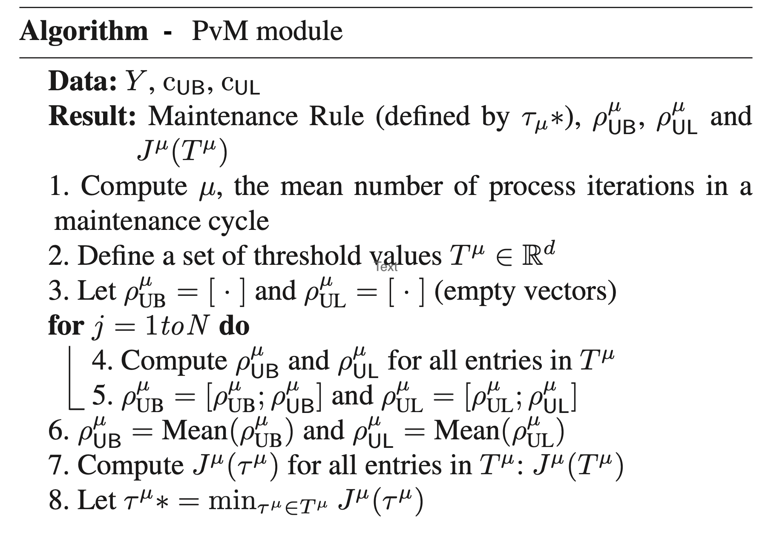
Simulated PvM Policy
based on the mean μ or median η of the maintenance cycle lengths and optimal action threshold T_{μ}∗
PvM can be triggered when
Algortihm : PvM [SSP+14]
ML for PdM: MC approach By: Ambuj Kumar Mondal

Slide 20
Use Case and Experiment
Semi conductor Manufacturing
replacing tungsten filaments used in ion implantation
every time a filament is changed, the tool is down for approximately 3 h making this the most important maintenance issue
during the process, the filament is heated and electrons are “boiled” off the heated filament.
electrons are then accelerated in the beamline area and impinge on the target wafers.
high values of pressure, voltage, and filament current can drastically reduce the lifetime of the filament.
ML for PdM: MC approach By: Ambuj Kumar Mondal

Slide 21
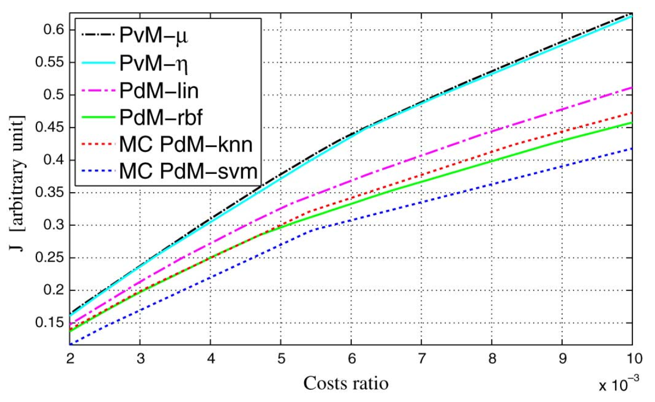
Experiment Results
Data Description
N = 33 maintenance cycles and total of n = 3671 batches
A total of 31 variables having have a time-series evolution during each run
extracted six features for each of the 31 time series maximum, minimum, average, variance, skewness, kurtosis
CuL = Cost of unexploited remaining lifetime
CuB = Cost to fix a breakdown
Fig 13: ratio of the costs, CuL/CuB for different approaches [SSP+14]
ML for PdM: MC approach By: Ambuj Kumar Mondal

Slide 22
Experiment Results
Semi conductor Manufacturing – Filament changing process
PdM and MC PdM outperform PvM approaches
For FuL, MC PdM achieve similar performance to the PdM approaches
In case of FuB, MC PdM-svm consistently achieved the best results
MC PdM-svm gave better performance than MC PdM-knn but is more time consuming
MC Pdm-kNN have lower operating cost.
Mc PdM allows to take maintenance decisions dynamically.
ML for PdM: MC approach By: Ambuj Kumar Mondal

Slide 23


Challanges and Future
Data is crutial, Data exploration is very difficult in manufacturing industry
MC PdM is available only for labelled data.
Using Unsupervised learning methods such as Deep Neural Networks
e-Maintenance, remote maintenance
Prescriptive Maintenance – Automated decision making, self healing systems
Sustainable and Ecological growth
ML for PdM: MC approach By: Ambuj Kumar Mondal

Slide 24
Conclusion
PdM avoids unnecessary scheduled maintenance of healthy systems unlike Preventive maintenance approaches.
PdM targets surgical maintenance and help reducing downtimes and optimize operational cost.
Multiple ML classifiers work in parallel to exploit the knowledge at each process iteration in order to enhance decision making.
MC PdM module is robust to variations in the operating costs associated with unexpected breaks and unexploited equipment part lifetime.
K-classifiers enhance process understanding and allow cost aware maintenance management decisions.
SVMs offer superior performance to k-NN classifiers.
Choice of the fault horizon m strongly affects the performance of the corresponding classifier in MC PdM.
ML for PdM: MC approach By: Ambuj Kumar Mondal

Slide 25
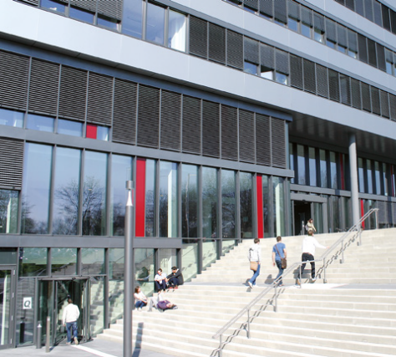
Thank you
ML for PdM: MC approach By: Ambuj Kumar Mondal

Slide 26
References
Papers-
[SSP+14] Susto et.al. Machine learning for predictive maintenance: A multiple classifier approach, pages 812– 820, 2014
[ZYW19] Zhang et.al. Data-driven methods for predictive maintenance of industrial equipment: A survey , 2019
[MPR18] Motaghare et.al. Predictive mainte- nance architecture, pages 1–4. IEEE, 2018
[Mob02] R Keith Mobley. An introduction to predictive maintenance. Elsevier, 2002.
Images-
[pic0] https://images.app.goo.gl/6KdrSqQNHngmQ2an9
[pic1] https://images.app.goo.gl/PnQtCRahUS7sjKNj9
[pic2] https://www.pinterest.com/pin/411446115928434072/
[pic3] https://images.app.goo.gl/Y6DwVDsqh6odgQjJ6
[pic4] https://images.app.goo.gl/vFGHvDcHgu2KGsxd6
[pic6] https://images.app.goo.gl/ibrZFqd914G6kCS28
[pic7] https://images.app.goo.gl/2CAtAQSptQTaNzA5A
[pic8] https://images.app.goo.gl/ggYKYPoVqJxuTdUbA
[pic11] https://images.app.goo.gl/VbYcLdTVmMjvhxGv7
[pic12] https://images.app.goo.gl/LW8bnJFEHLvBax2q6
ML for PdM: MC approach By: Ambuj Kumar Mondal

